Slide 1
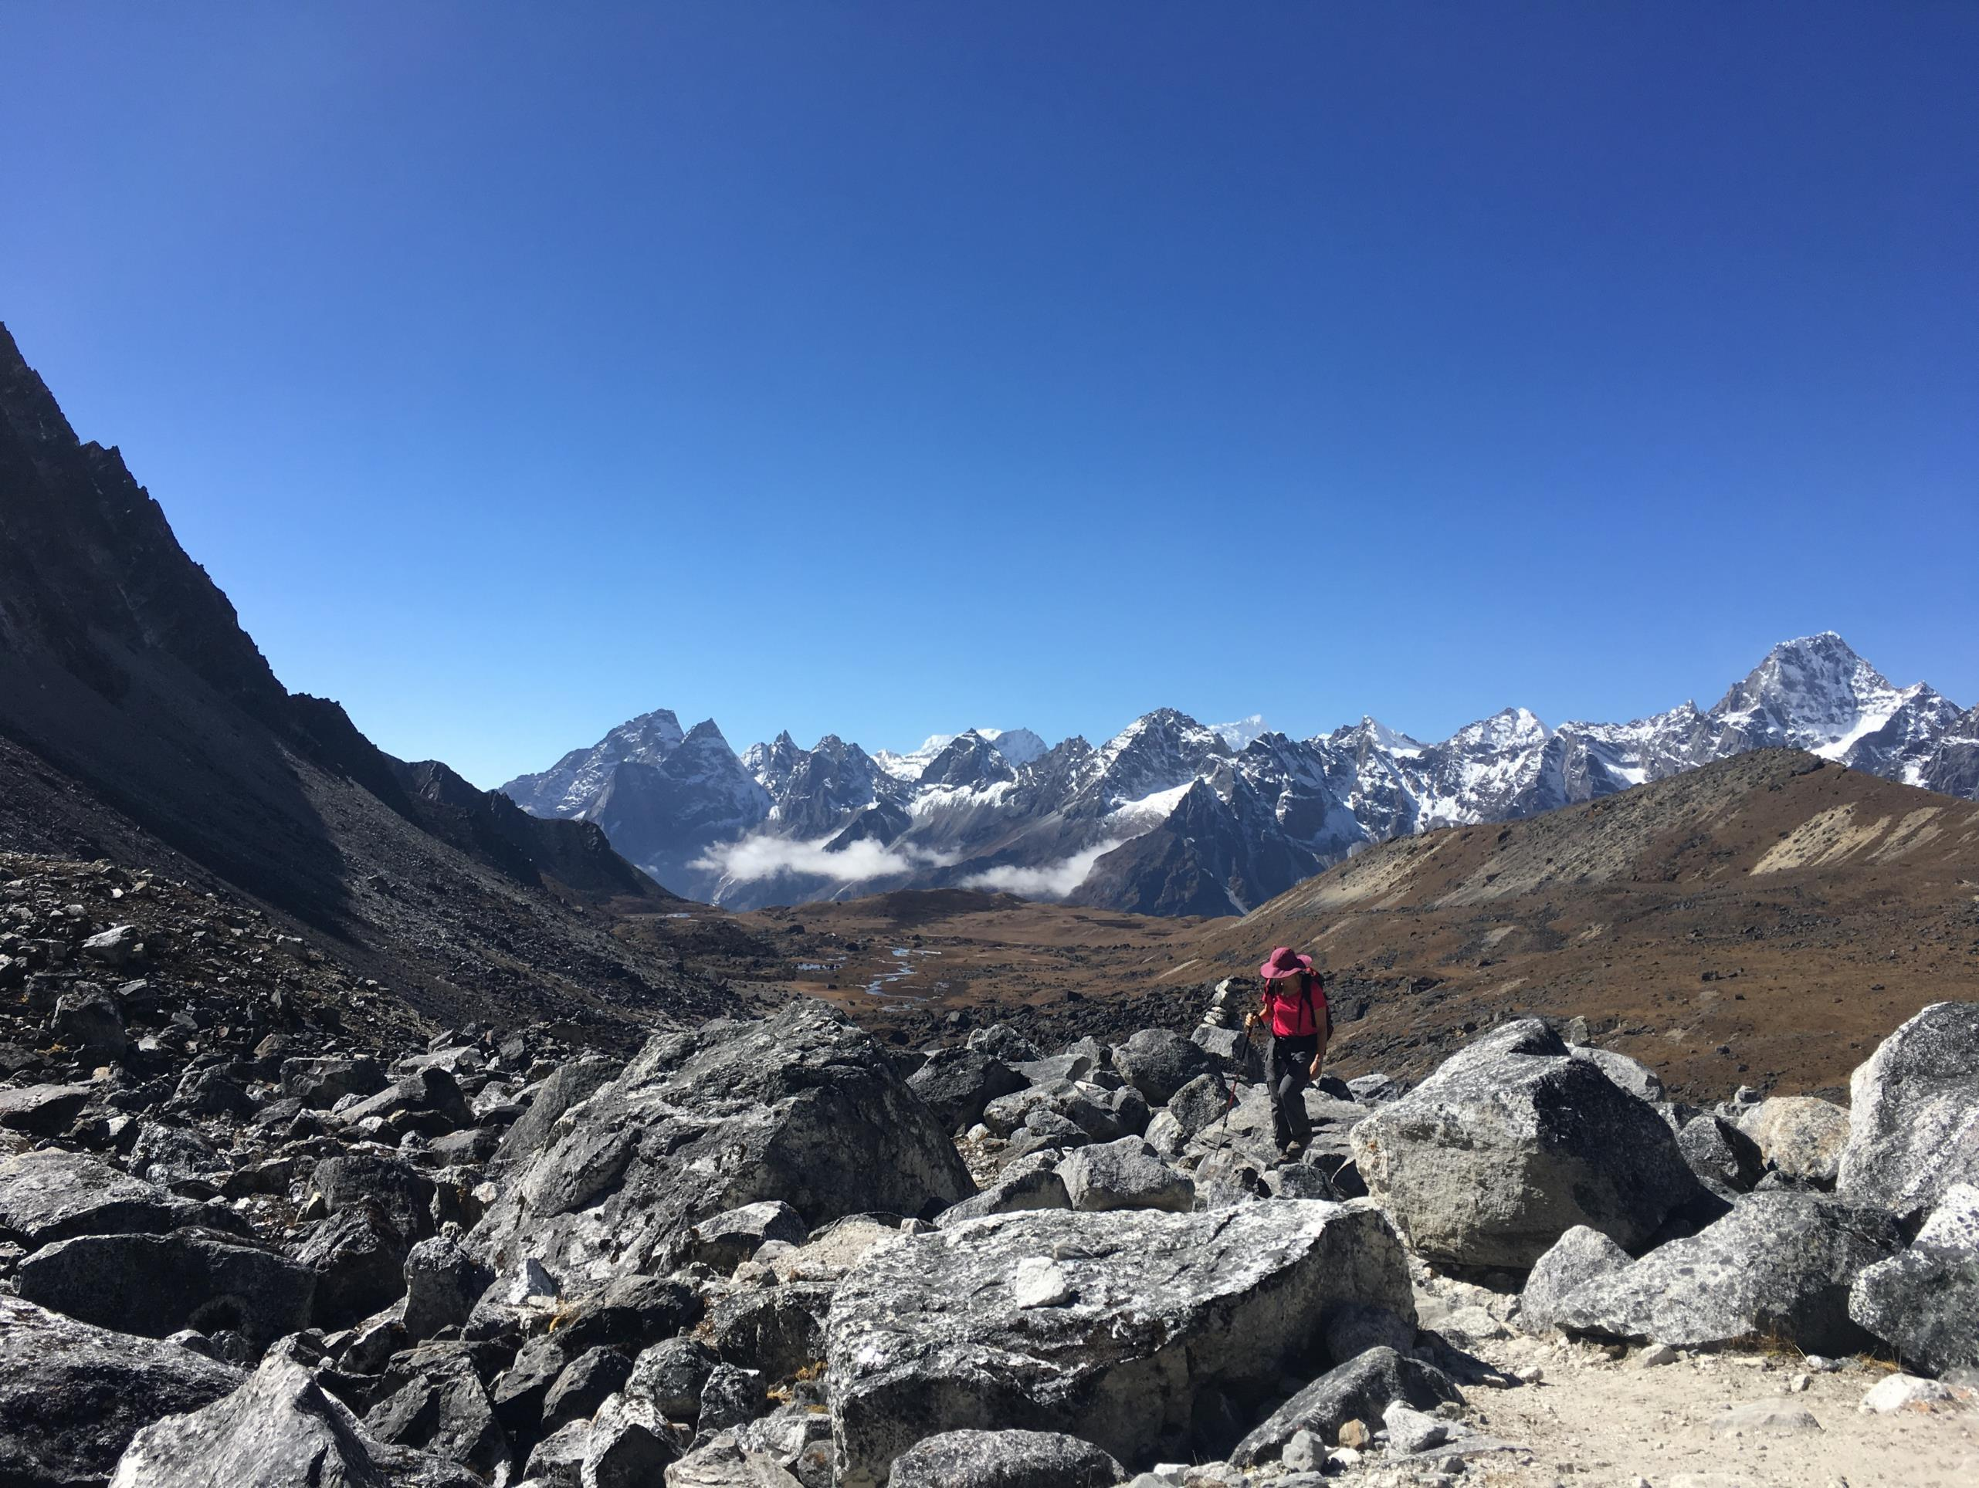

Secrets of the Cosmos
MARILAG DIMATULAC

Slide 2
SECRETS OF THE COSMOS
Questions of the Day
What’s the difference?
Is it expensive?
Does it perform?
SWETUGG 2020

Slide 3

SECRETS OF THE COSMOS
WHAT, WHY, WHY NOT
NoSQL
Globally Distributed
5 Consistency Levels
Multi-Model
Multi-API
SWETUGG 2020
Notes:
NoSQL – data structure varies. Use sql if you need to enforce schema
Schemaless
Automatic indexing
Global Distribution
You pay per region
Can use as failover
Can have multi master vs just using global distributed cache which is normally only eventual
Consistency
Strong cannot span more than 5000 mile
Cannot dynamically change to level stronger than default

Slide 4
“Polyglot Persistence, like polyglot programming, is all about choosing the right persistence option for the task at hand.”
Scott Leberknight, 2008
”

Slide 5
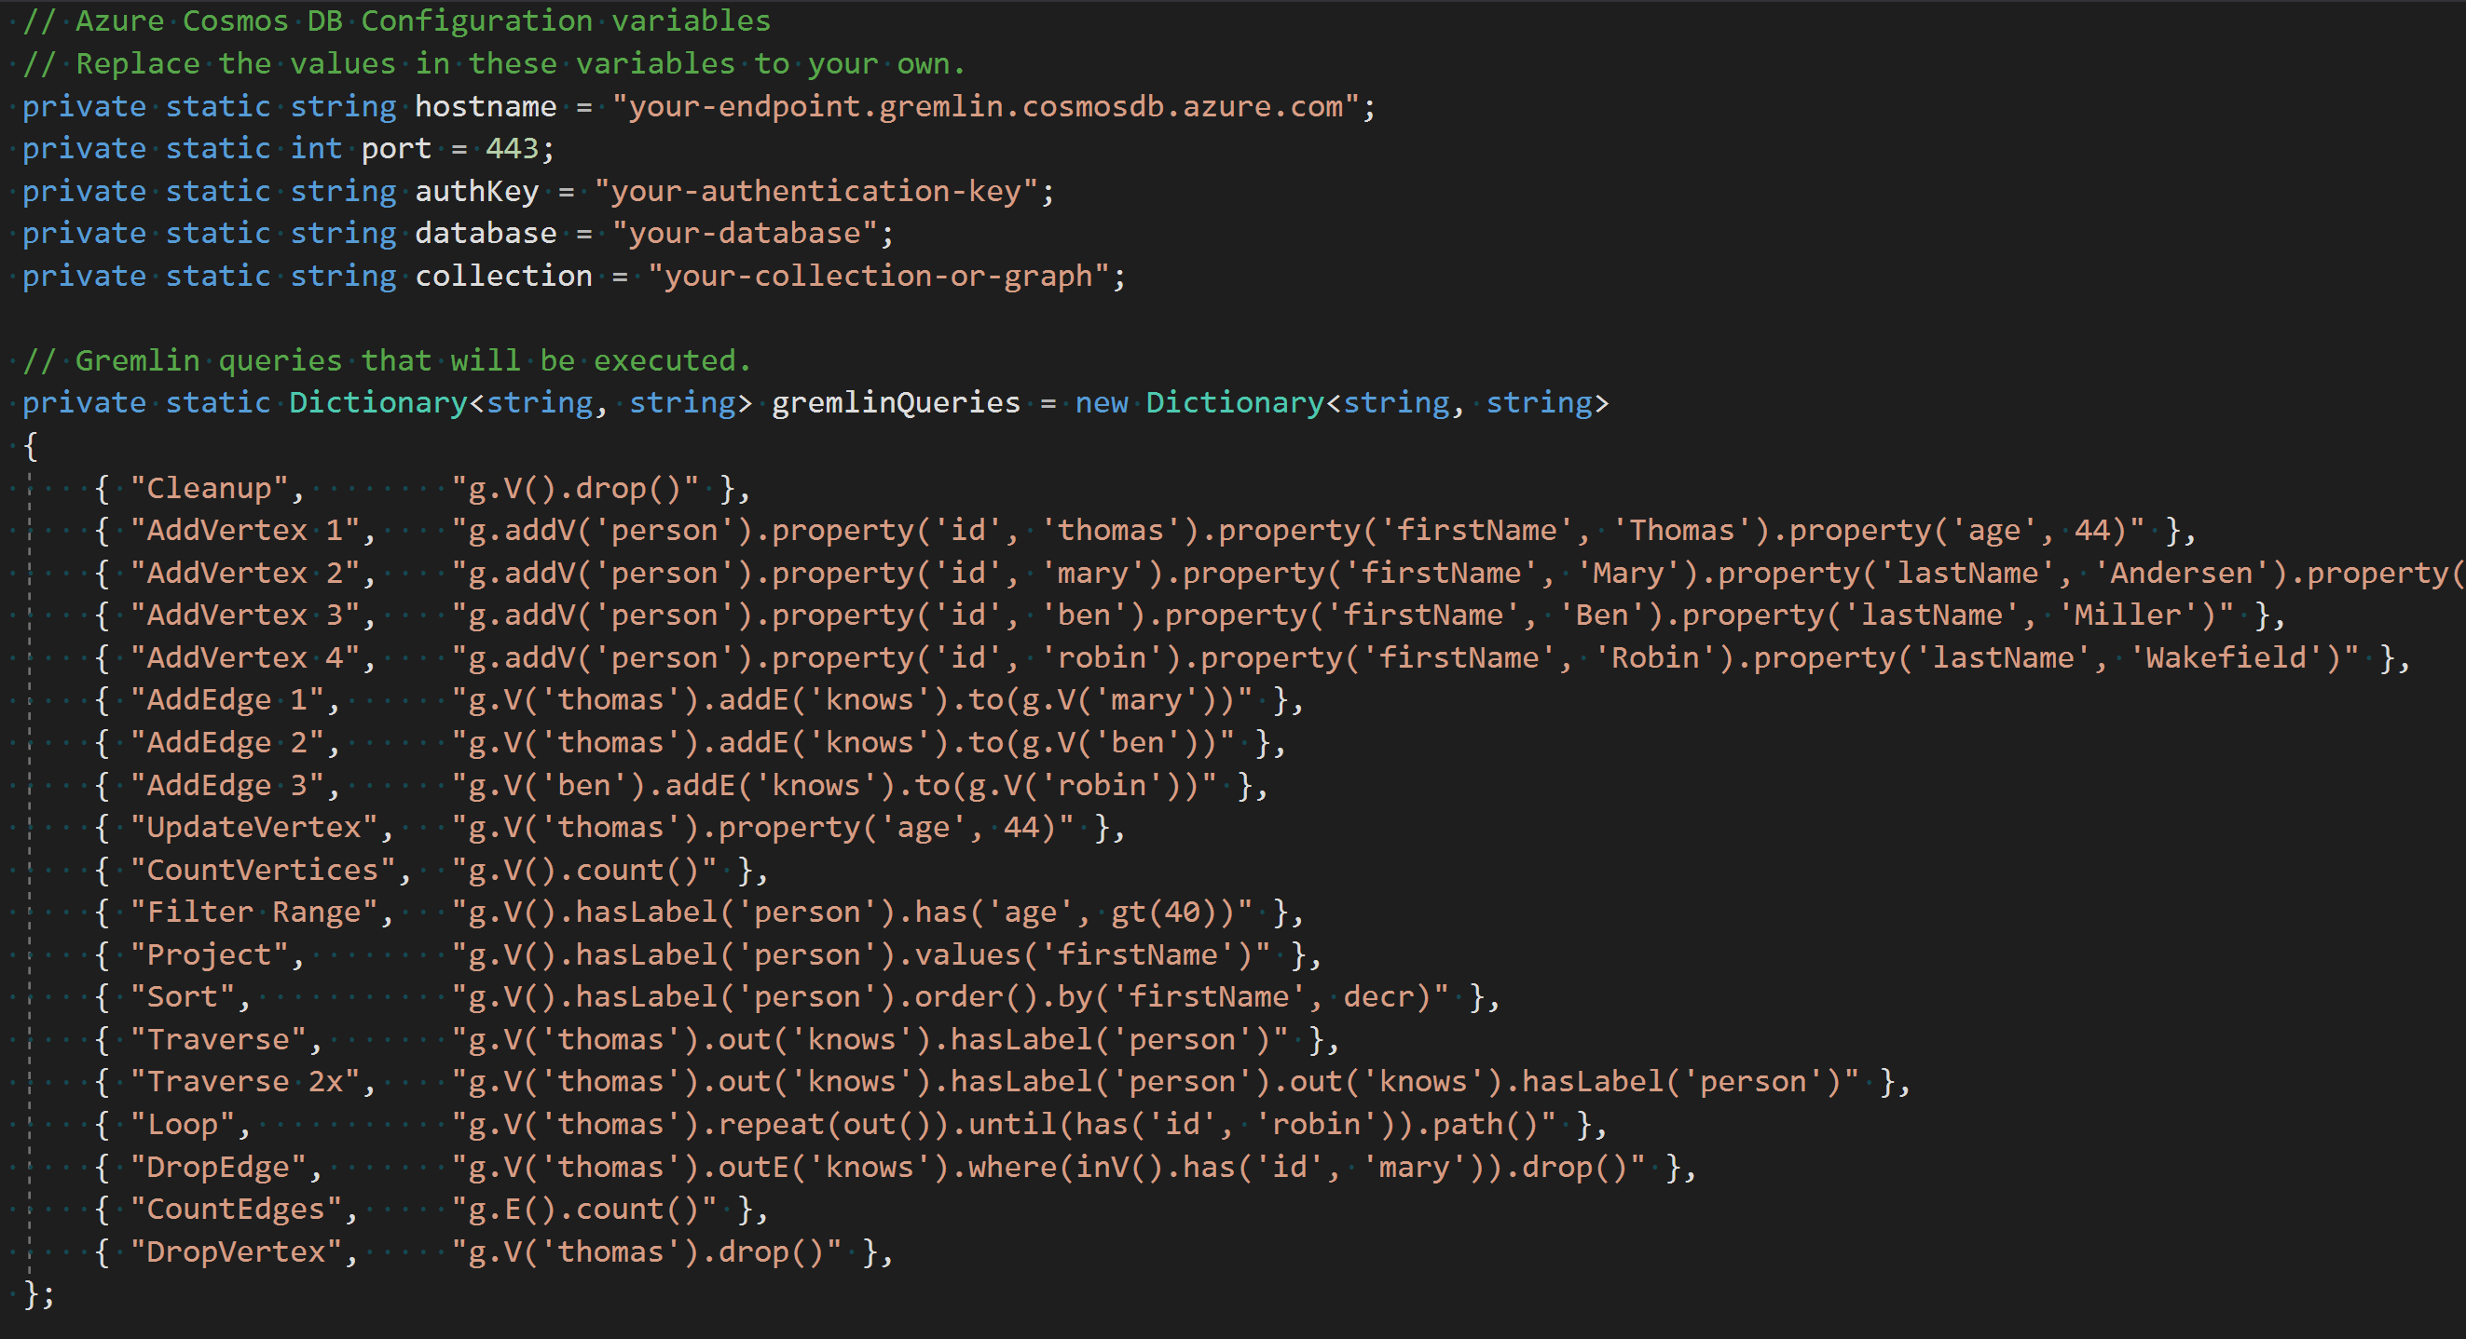

Slide 6
Is it expensive?
SECRETS OF THE COSMOS
Questions of the Day
SWETUGG 2020

Slide 7
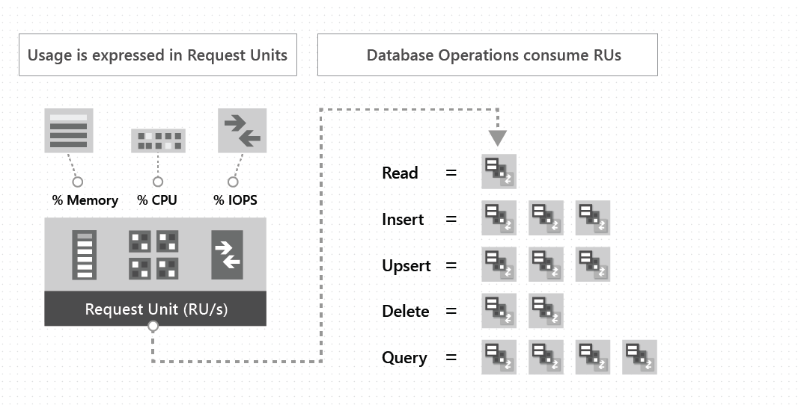
t
Request Units
SECRETS OF THE COSMOS
REQUEST UNITS
Manual
On-Demand
Auto-Pilot
1 KB Read = 1 RU
1 KB Write = approx. 6 RU
Minimum 400/600 RU per second = 24 USD
10,000 RU per second = 20 US per day
SWETUGG 2020

Slide 8
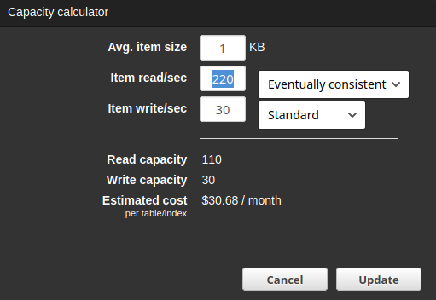
t
DynamoDB vs CosmosDB
SECRETS OF THE COSMOS
REQUEST UNITS
Manual
On-Demand
Auto-Pilot
SWETUGG 2020

Slide 9
SECRETS OF THE COSMOS
Questions of the Day
Does it perform?
SWETUGG 2020

Slide 10
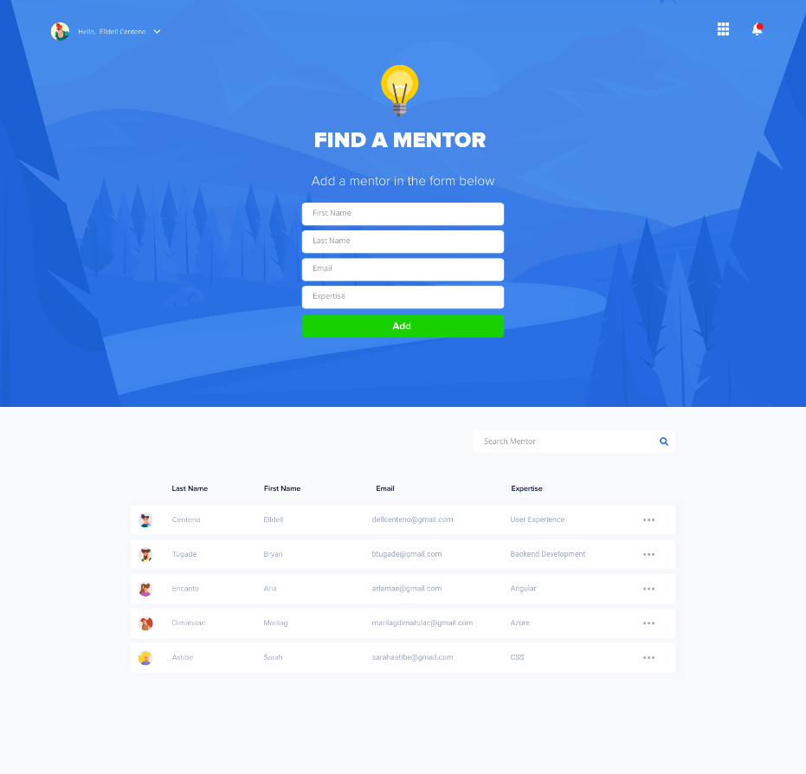

SECRETS OF THE COSMOS
SCENARIO + USER STORIES
Mentor Me
Get mentors
Get Classes by mentors
Get Registrations on Classes
Get Registrations per student
Find relevant classes
SWETUGG 2020

Slide 11
SECRETS OF THE COSMOS
SCENARIO + USER STORIES
Mentor Me
500 Mentors
2705 Classes
41712 Registrations
SWETUGG 2020

Slide 12
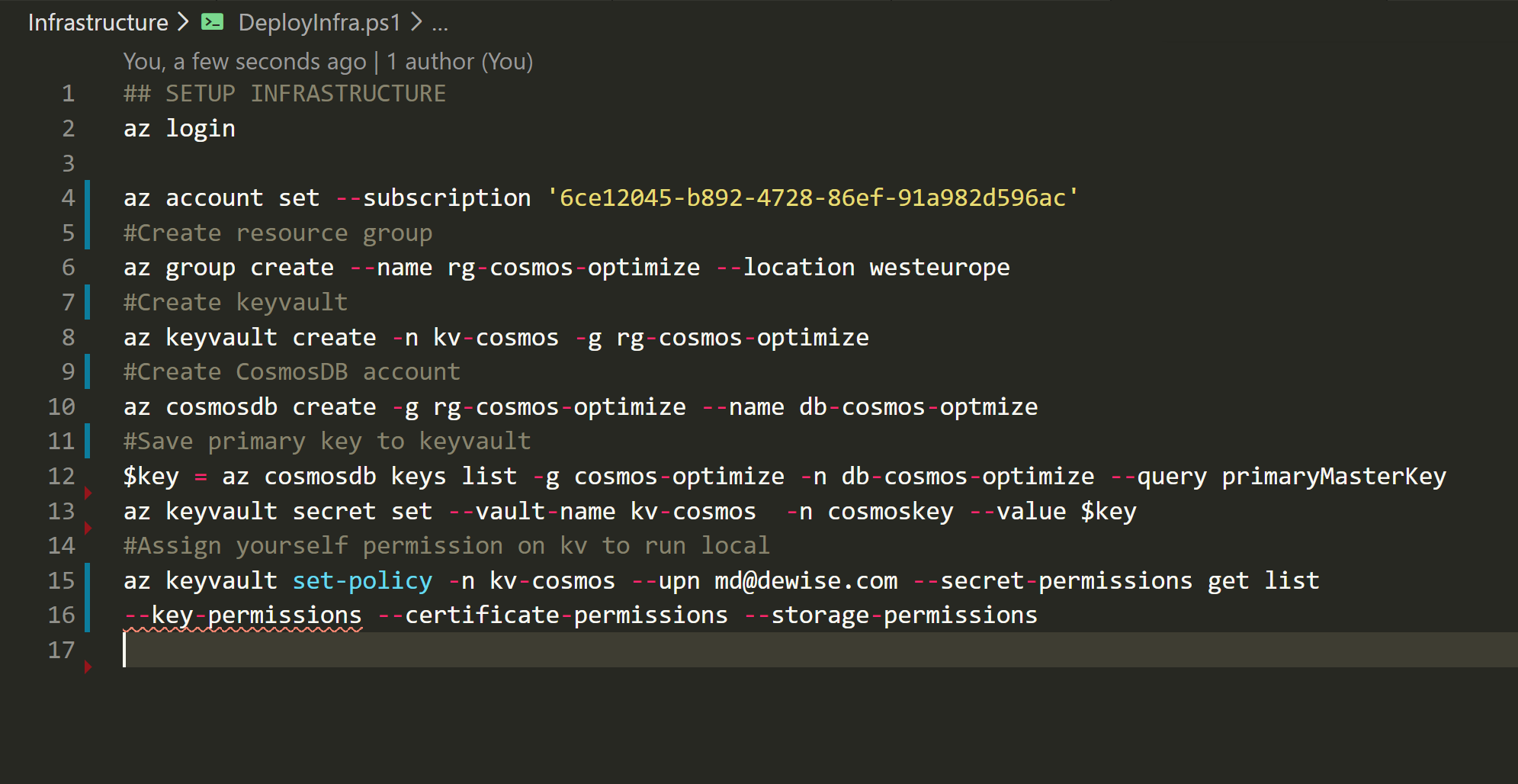
Setup POC
t
Setup POC resources
SECRETS OF THE COSMOS
SWETUGG 2020

Slide 13
Modeling
SECRETS OF THE COSMOS
SWETUGG 2020

Slide 14
SECRETS OF THE COSMOS
MODELS
Embedded
Reference
Individual
INTELLIGENT CLOUD

Slide 15
SECRETS OF THE COSMOS
MODELS
 | Embedded | Reference | Individual
I need performance 10,000 RU Bulk Execution 00:02:53.43 | Items: 500 Max RU: 362.86 00:00:13.46 | Classes: 2705 MaxRU: 64.38 Mentors: 500 MaxRU: 11.62 00:00:17.34 | Mentors 500 MaxRU: 11.62 00:02:16.99 Classes: 2705 MaxRU: 8.57 00:02:16.99
I’m on a budget
Embedded
Reference
Individual
SWETUGG 2020

Slide 16
SECRETS OF THE COSMOS
MODELS
 | Embedded | Reference | Individual | Synthetic
View mentor’s classes
View mentor’s students
View student’s classes
Find relevant mentors and classes
Embedded
Reference
Individual
SWETUGG 2020

Slide 17
SECRETS OF THE COSMOS
MODELS
 | Embedded | Reference | Individual | Synthetic
Pros | Single Read | -No upper limit -Single/Multiple Read | -Different partition stragegy | -can balance partition
Cons | -Larger file size -Slower query -Updates to a single file | -Partition | -Multiple Read -Complex -More storage | -slow
Use For | -Small size -Tree relationship | -Master-Details with unknown upper limit | -Microservices
Embedded
Reference
Individual
SWETUGG 2020

Slide 18
SECRETS OF THE COSMOS
MODELS
Embedded
Reference
Individual
PROs
- Single document read
CONs
INTELLIGENT CLOUD

Slide 19
Partitioning
SECRETS OF THE COSMOS
SWETUGG 2020

Slide 20

SECRETS OF THE COSMOS
Container
TOPOLOGY
Container
Logical Partition -show
Physical Partition
Region
Global Distribution
SWETUGG 2020

Slide 21
Optimization
SECRETS OF THE COSMOS
SWETUGG 2020

Slide 22

SECRETS OF THE COSMOS
TARGET
Latency
Availability
Consistency
SWETUGG 2020

Slide 23
SECRETS OF THE COSMOS
OPTIMIZE
Consistency
Point Reads
Indexing
SWETUGG 2020
Notes:
Let’s play a little bit with consistency and location
Set to session
Run insert with strong consistency and explain error
Set consistency to strong
Run insert with strong. What’s the ru
Run insert with eventual. What the ru and response time
Changing consistency level takes a cople of minutes. You can’t use a stronger consistency than the service level and you must restart the app to see the change

Slide 24
SECRETS OF THE COSMOS
OPTIMIZE
Max Item
Max Concurrency
Serialization/Deserialization
Query
SWETUGG 2020

Slide 25
SECRETS OF THE COSMOS
CONSIDERATIONS
SQL Syntax
Data migration
Tooling
SWETUGG 2020

Slide 26
SECRETS OF THE COSMOS
READINESS
Multi-Tenancy
System Migration
Operations
SWETUGG 2020

Slide 27



SECRETS OF THE COSMOS
Where should I invest?
STRATEGIC PHASES
Model
Configuration
Code
Monitor
SWETUGG 2020

Slide 28

SECRETS OF THE COSMOS
BUILD FOR THE PLANET
L A U N C H
SWETUGG 2020

Slide 29
Sources & Links
SECRETS OF THE COSMOS
https://azure.microsoft.com/en-us/blog/how-skype-modernized-its-backend-infrastructure-using-azure-cosmos-db-part-1/
https://thenextweb.com/contributors/2019/01/30/digital-trends-2019-every-single-stat-you-need-to-know-about-the-internet/
https://azure.microsoft.com/en-us/try/cosmosdb/
SWETUGG 2020

Slide 30

SECRETS OF THE COSMOS
@marilag
Marilag Dimatulac
SOLutions architect
Secrets of the Cosmos
SWETUGG 2020
Notes:
1
Dewise Solution Architect. Certified Azure Developer and I’ve been working with Azure for almost 4 years
Wonderful team build really advanced cloud applications for Enterprise
I contribute a lot to the community, running Azure User Group Manila, and presenting at several meetups and conferences in Scandinavia
I live in Copenhagen and travels to Manila a lot
Twitter @Marilag IG ladiebugged

